Slide 1
Identifying Suicidal Tendency among Young Students of Bangladesh Using Machine Learning
Presented By
Group-23
Md. Shakil Hossain-2023
Mahbubur Rahman-2024
Nahidul Islam-2028

Slide 2
Overview
Introduction
Objective
Research Question
Literature review
Data Description
Proposed Model
Project Plan

Slide 3
Introduction
The thesis proposes a machine learning approach for Identifying Suicidal Tendency among Young Students of Bangladesh Using Machine Learning. The approach involves collecting data on student characteristics and behaviours, preprocessing and engineering the data to create features suitable for machine learning, evaluating various machine learning models, and deploying the best-performing model to a production environment.
The thesis concludes that the proposed machine learning approach has the potential to significantly improve the ability to predict suicide risk among students in Bangladesh. This could lead to earlier intervention and prevention of suicide, which would save lives

Slide 4
Objective
Develop a machine learning model that can analyze patterns and identify potential signs of suicidal tendencies in young students based on their online activities, such as social media posts, search history, and online interactions.
Collect and analyze a comprehensive dataset consisting of various factors related to mental health, such as depression symptoms, anxiety levels, stressors, and previous history of self-harm or suicidal ideation among young students in Bangladesh.
Explore different machine learning algorithms, such as decision trees, logistic regression, or support vector machines, to build a predictive model that can accurately detect and classify young students at risk of suicidal tendencies

Slide 5
Continue
Collaborate with mental health professionals, educators, and counsellors to incorporate their expertise and domain knowledge into the model development process, ensuring the inclusion of relevant features and validation of the results.
Evaluate the machine learning model’s performance using appropriate metrics, such as accuracy, precision, recall, and F1 score, to measure its effectiveness in identifying and predicting suicidal tendencies among young students.

Slide 6
Research Question
Can a machine learning approach be used to predict suicide risk among Young Students in Bangladesh accurately?

Slide 7
Literature Review
Authors/Title | Findings
Ryan M. Hill, Benjamin Ooster- hoff and Calvin Do “Using Ma- chine Learning to Identify Suicide Risk: A Classification Tree Ap- proach to Prospectively Identify Adolescent Suicide Attempters” (2019) | The findings showed that two clas- sification tree solutions, with cor- responding sensitivity/specificity ra- tios of 90.6%/70.9% and 69.8%/85.7%, maximized risk prediction.
Melissa Macalli1,7, Marie Navarro1,7, Massimiliano Orri1,2, Marie Tournier1,3, Rodolphe Thi´ebaut1,4,5, Sylvana M. Cˆot´e1,6 and Christophe “A Tzourio1 approach for predicting suicidal thoughts and behaviours among col- lege students” | With an AUC of 0.8, sensitivity of 79% for girls and 81% for boys, and positive predictive value of 40% for females and 36% for boys, the models demonstrated strong predictive performance.

Slide 8
Data Description
We used a survey form to collect data by asking different types of questions.
We divide our form into 2 section. In first section we ask about their age, education level, division and so on.
In second section we ask them different types of question that are related to suicide. For example Have you ever been physically, abused? Is there a history of suicide in your family? Have you ever expressed your feelings of depression to someone?
Form Link: https://forms.gle/kWd2LFtGwnUfyGRSA

Slide 9
Proposed Model
Suicide risk is a complex phenomenon that is influenced by a variety of factors, including student characteristics (e.g., age, gender, religion, ethnicity, academic performance, etc.), behaviours (e.g., absenteeism, tardiness, disciplinary problems, etc.), and environmental factors (e.g., family environment, peer environment, etc.). Machine learning algorithms can be trained to learn from data on these factors and make accurate predictions about suicide risk. Machine learning models can be generalized to new data, meaning that they can be used to predict suicide risk for students who were not included in the training dataset.

Slide 10
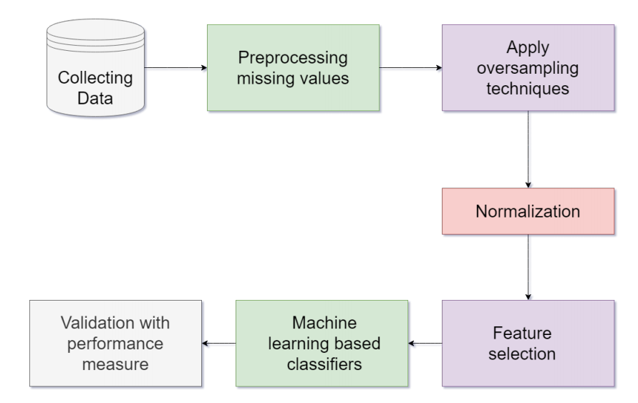
Project Plan

Slide 11
Continue
The project will be completed in different phases:
Data collection: We collect data by using a Google survey form.
Data Cleaning:
• Impute the missing values with the column’s mean, median, or mode.
• Drop the rows with missing values.
• Use a machine learning model to predict the missing values like isnull() and heatmap().
Normalize the data: Normalization is scaling the data so that all features have
similar values. This can improve the performance of machine learning models by
making the parts more comparable.
Model training: The second phase will involve training the machine learning model
on the collected data. The model will be prepared using a supervised learning algorithm like SVM.
Model evaluation: The third phase will evaluate the machine learning model’s
performance on a holdout dataset of unseen transactions. The model’s performance
will be evaluated using accuracy, precision, and recall metrics.

Slide 12
Conclusion
Suicide is a major public health problem in Bangladesh, and young students are particularly at risk. Early identification and intervention are essential for preventing suicide among young people. Machine learning has the potential to play a significant role in improving the early identification and prevention of suicide among young students. This study has demonstrated the feasibility of using machine learning to identify young students at risk of suicide in Bangladesh

Slide 13
Future Work
Refining models will be continuous, with a keen eye on optimizing algorithms based on evolving data patterns.
Exploring advanced techniques, such as delving into natural language processing for deeper textual analysis and considering incorporating reinforcement learning, will be a natural progression.
Establishing seamless connections with healthcare systems is a logical step, ensuring a collaborative approach between educational institutions and mental health professionals.
Provide textual suggestion according their suicidal tendency rate

